Slide 1

Section 7.4 Integration of Rational Functions by Partial Fractions
Lecture 2
PDF 3 Cases

Slide 2
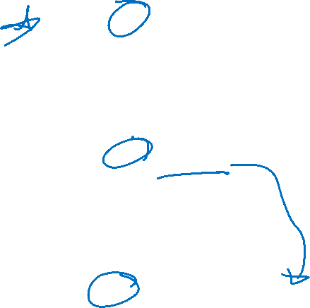
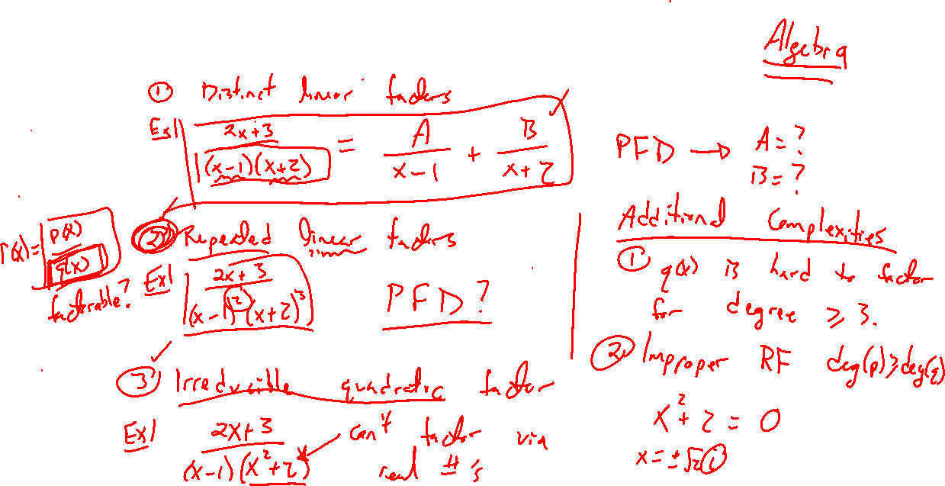
Partial Fraction Decomposition 3 Cases
Notes:
Distinct linear factors
Repeated linear factors
Irreducible quadratics

Slide 3

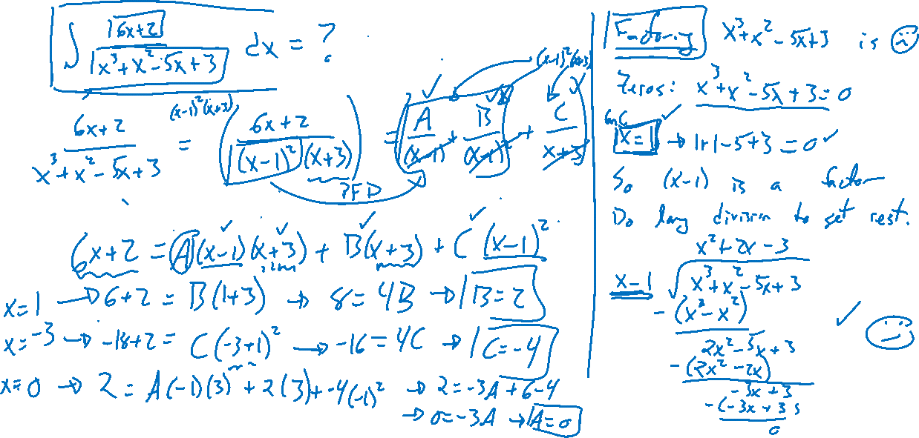
Example: Repeated Linear Factor
Notes:
\int (6x+2)/(x^3+x^2-5x+3) dx
Note, x^3+x^2-5x+3=0 for x=1. Then (x-1) is a factor and do long division. Check zeros on Demos.

Slide 4
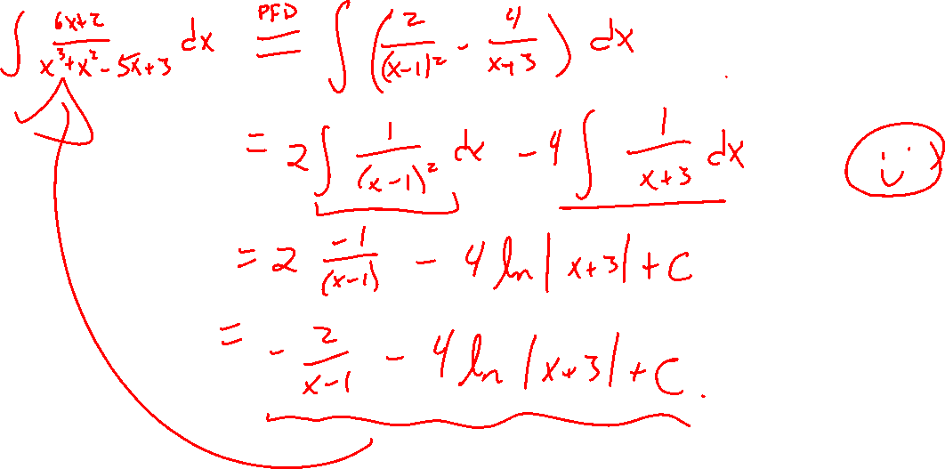
Example Continued

Slide 5
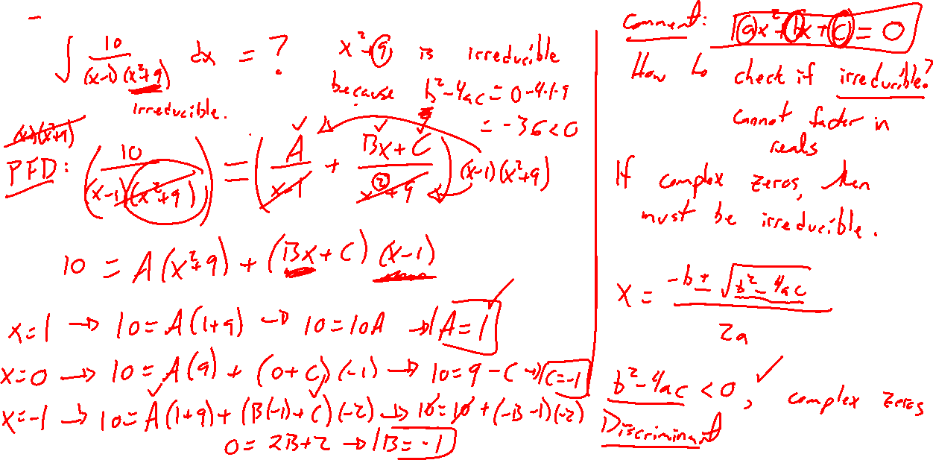
Example: Irreducible Quadratic
Notes:
10/(x-1)(x^2+9)

Slide 6
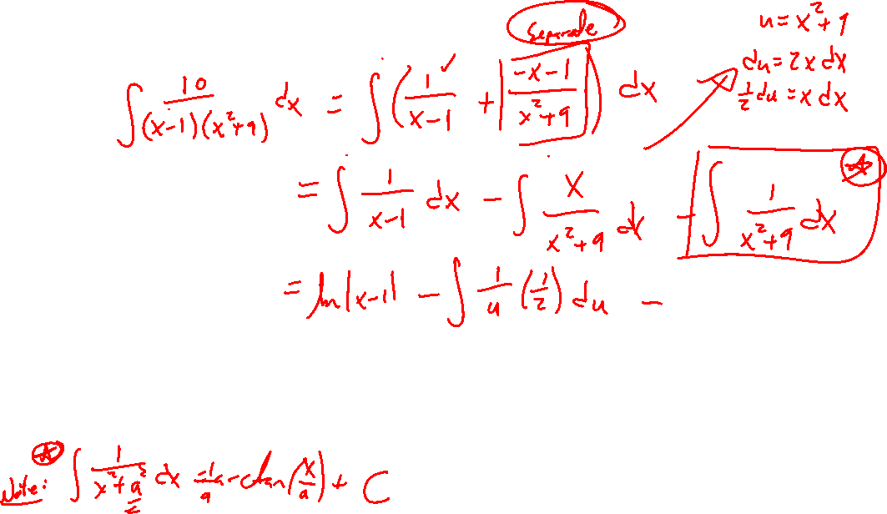
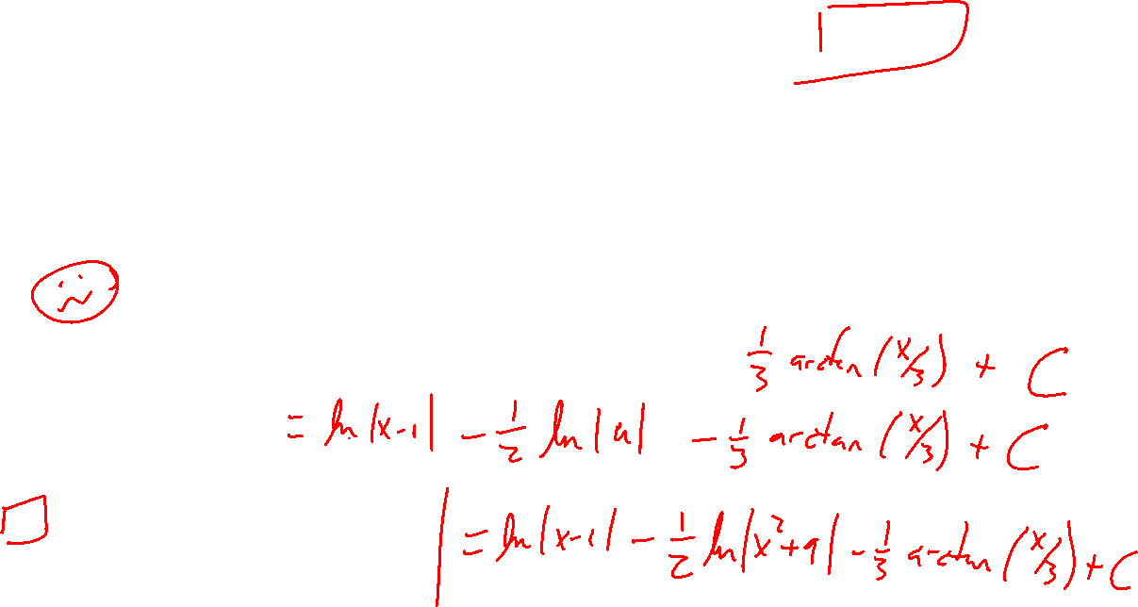
Example Continued

Slide 7
Example: Try on Own
Notes:
(x^3+6x-2)/(x^4+6x^2)

Slide 8
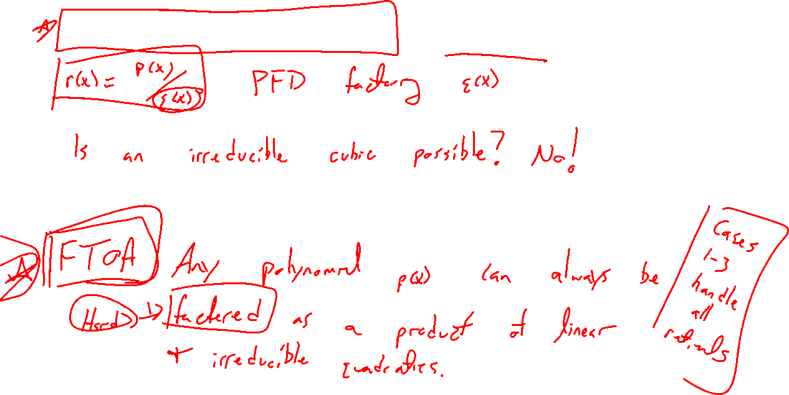
Fundamental Theorem of Algebra
Notes:
Google: FTOA
Google: FTs of Math

Slide 9
Example: Twisty Challenges
Notes:
Improper: (3x-2)/(x+1)
Irreducible: (2x+4)/(x^2+2x+2)

Slide 10

Section 7.4: Textbook Examples and Exercises
Rework examples 1, 2, 4, 5, 6, 9 in the text. Steps:
Write down a problem.
Close the book and attempt on own.
Check / correct your solution against the text solution.
If needed, rewrite the problem to be of the quality of the text solution.
Complete exercises 4, 9, 17, 19, 23, 29
Write solutions of the same quality as in lecture and text solutions.
Check your solution against the answer in the back of the book.

Slide 11

Section 7.4 Homework Submission to Canvas
Preview of section
Skim the section in text and write a short paragraph summary.
Give a bulleted list of all important definitions, theorems, and formulas without details.
Notes on video lectures
Take notes on everything written on slides including all details, worked examples, on-own activities, as well as your own thoughts and questions.
Try on-own activities first, then write down provided solution next to it for comparison.
Worked examples from the text
Write down the problem and attempt without looking at the solution.
Use the solution to write the best explanation you can.
Solutions to textbook exercises
Model approaches and explanations given in the video lectures and textbook examples.
Final reflection of section
List the key takeaways to remember as a bulleted list.

